Slide 1
Cross Sell Pred
Presentation

Slide 2
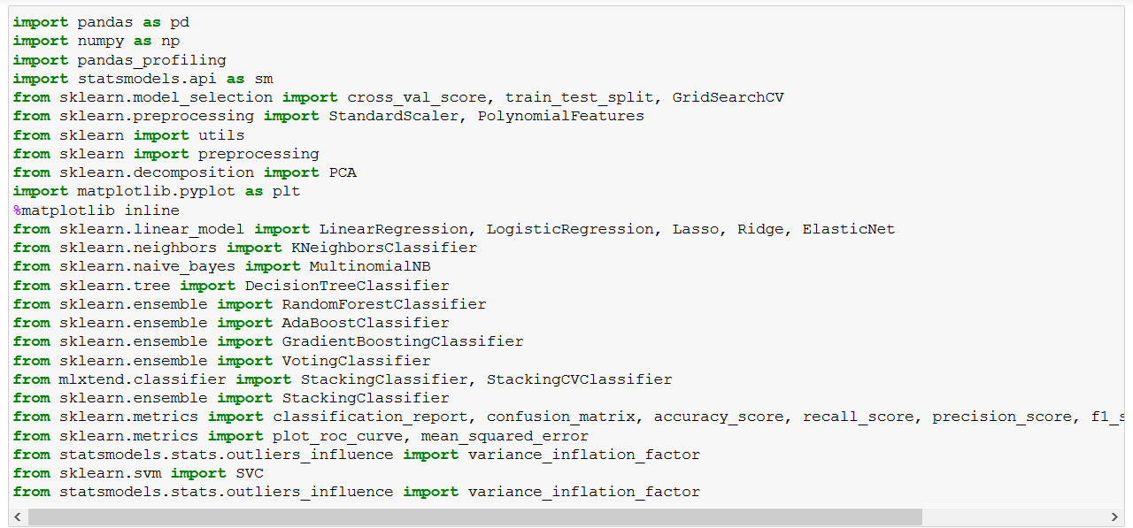
Libraries used

Slide 3
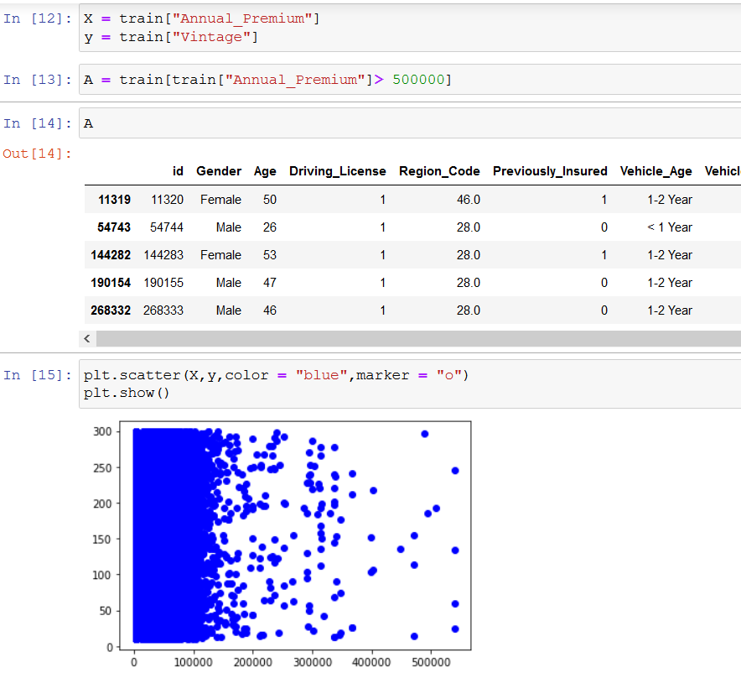
Pre Processing - 1

Slide 4
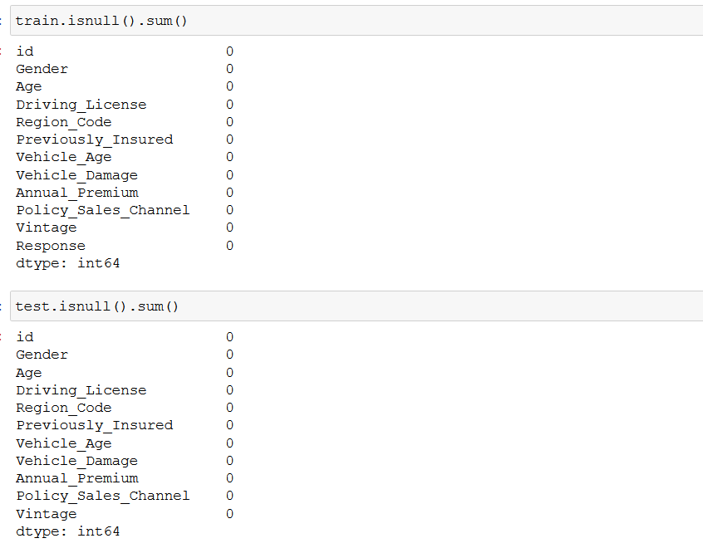
Pre Processing - 2

Slide 5
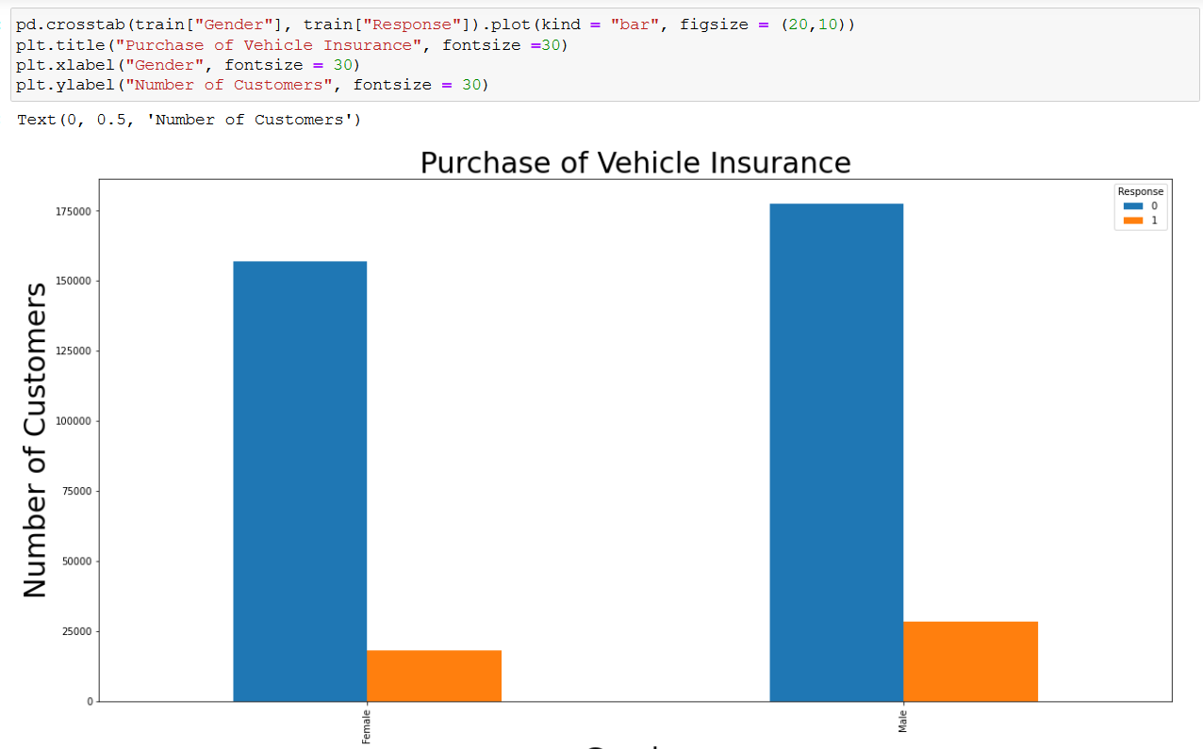
Pre Processing - 3

Slide 6
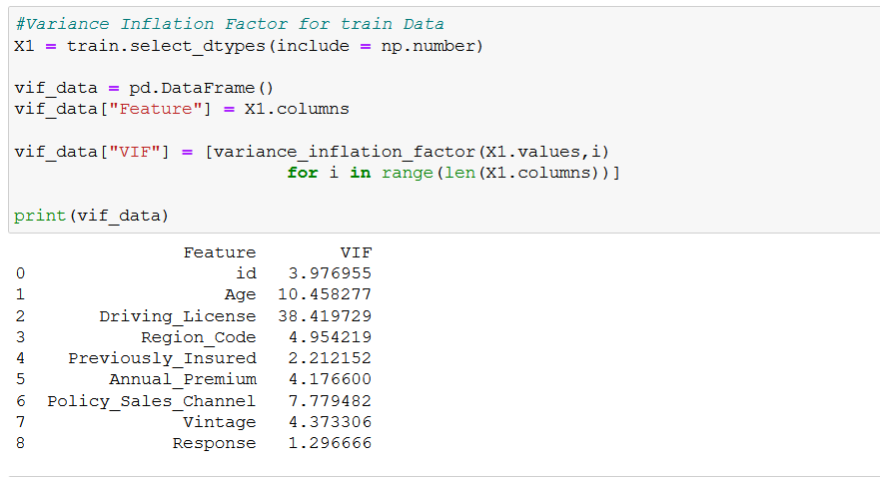
VIF

Slide 7
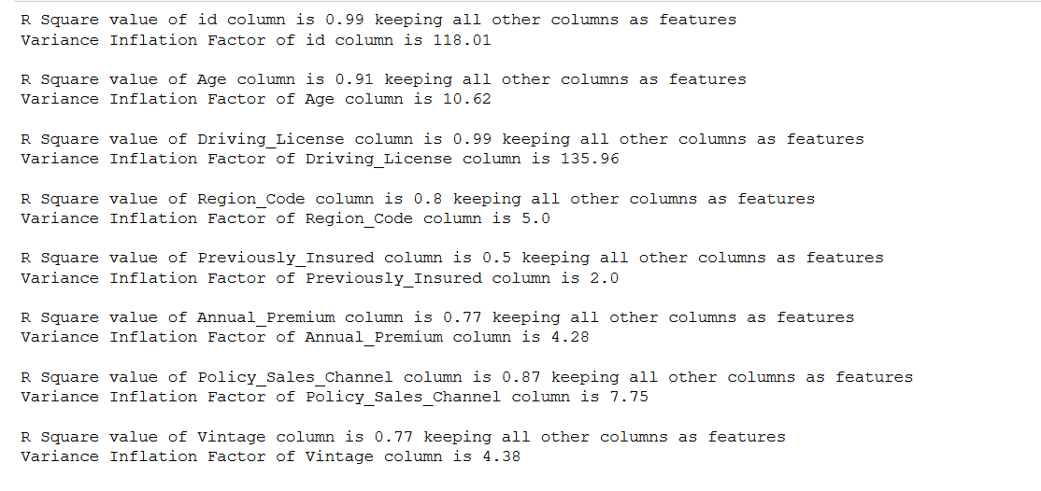
Variance as a percent with reference to other clmns

Slide 8
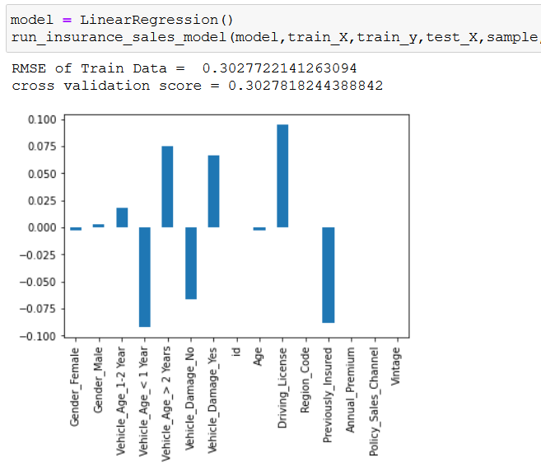
Linear Regression

Slide 9

Ridge Regression

Slide 10
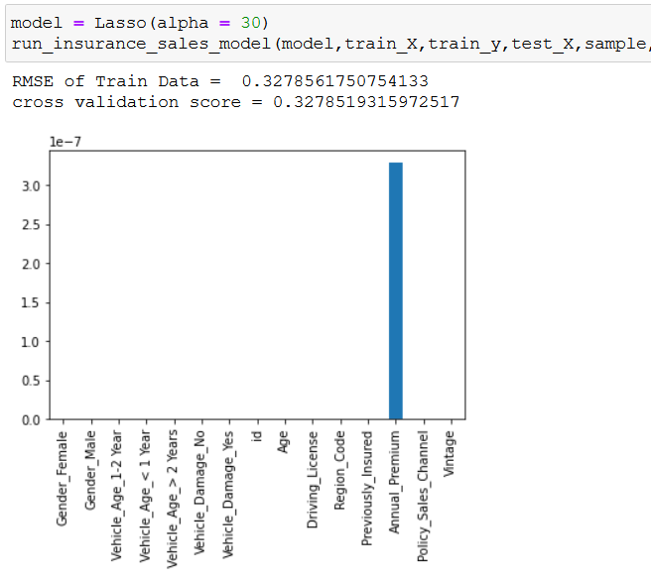
Lasso Regression

Slide 11
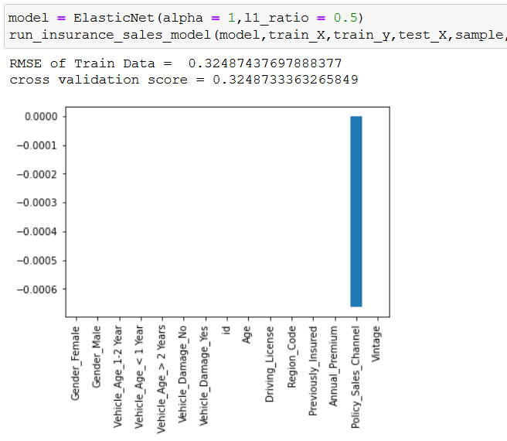
ElasticNet Regression

Slide 12
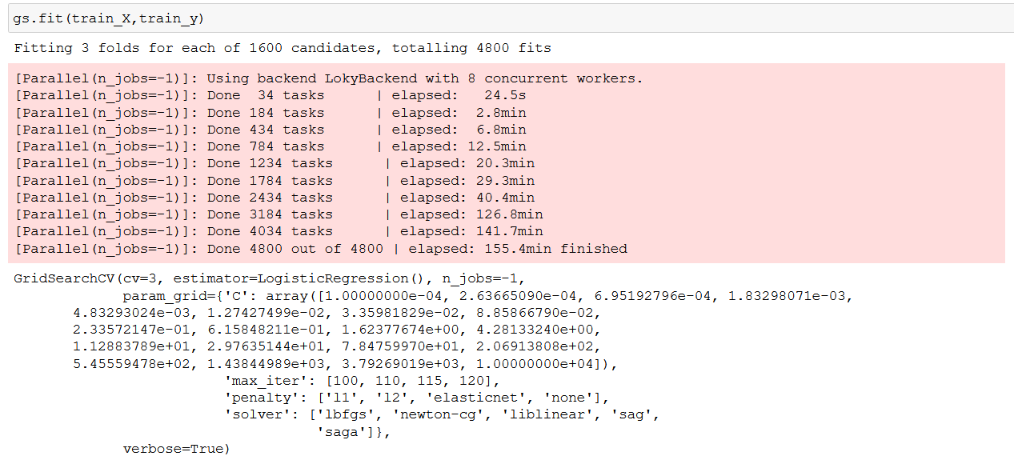
Grid Search for HyperParameter Tuning

Slide 13
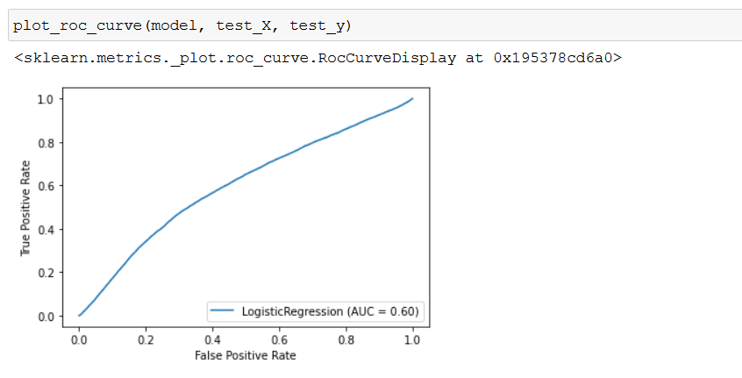
ROC-AUC Curve

Slide 14
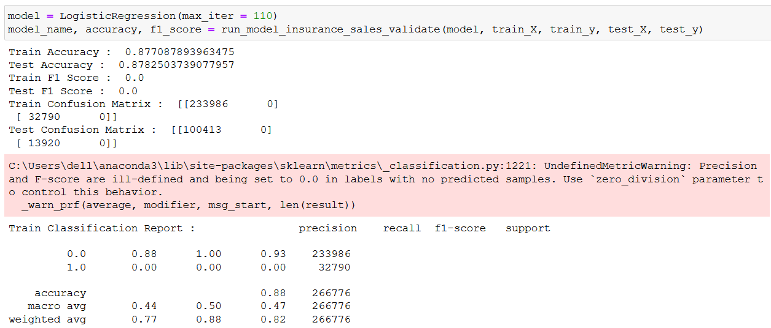
Logistic Regression

Slide 15
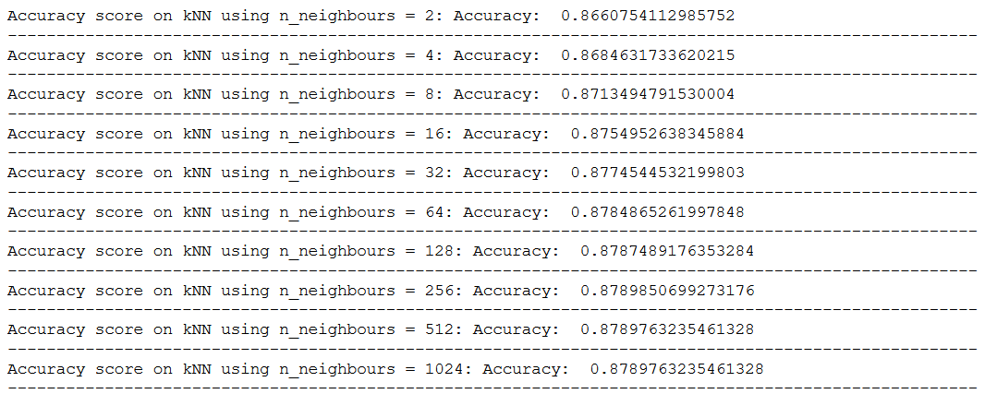
KNN Algorithm
KNN Algorithm for K = 2 to 1024

Slide 16
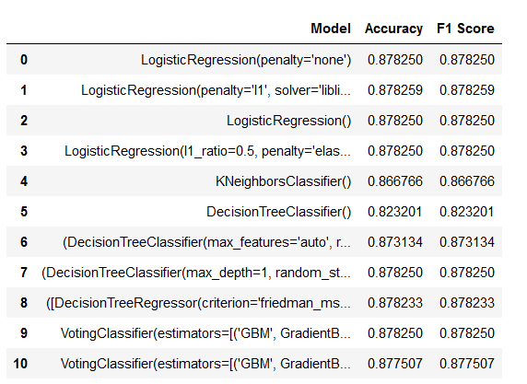
Gradient Boost and Random Forest with Classifiers

Slide 17
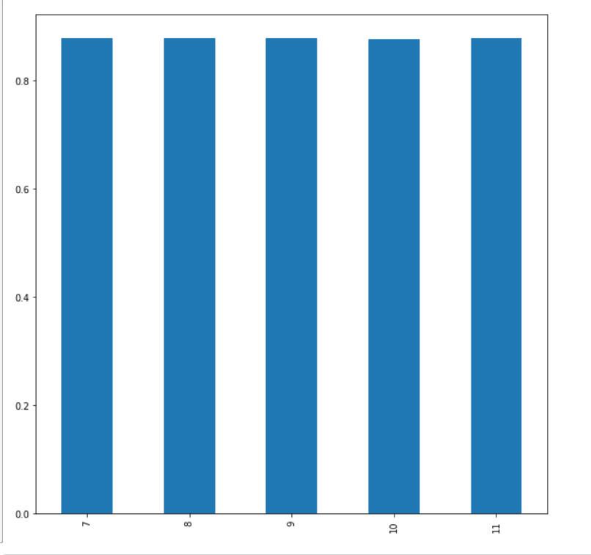
Final Graph Showing Increase in Accuracy

Slide 18
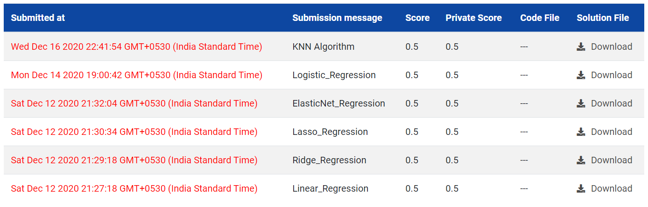
Finally Scores on Analytics Vidhya

